Slide 1
Objective
• Predict daily energy consumption using historical data.
• Apply LSTM model for time-series forecasting.
• Generate optimization suggestions based on patterns.

Slide 2
Abstract
This project aims to forecast solar energy consumption using LSTM-based deep learning models. It leverages historical data including temperature and employee count to generate predictions. The system also suggests optimization strategies to improve energy usage efficiency.

Slide 3
Problem Statement
• Users lack predictive insights into energy usage.
• Manual monitoring is inefficient and error-prone.
• Need for a system to forecast and optimize energy consumption using machine learning.

Slide 4
Latest Literature Review
1. Forecasting electric consumption using LSTM - IEEE, 2021
2. Time-series energy models - Elsevier, 2022
3. Solar data prediction with ML - Springer, 2021
4. Neural networks in smart grids - IEEE, 2020
5. Temperature vs load forecasting - Elsevier, 2021
6. Optimization-based recommendations - Springer, 2022
7. Data preprocessing for ML energy models - ACM, 2020
8. Energy trend visualization tools - IEEE, 2021
9. Comparative study: ARIMA vs LSTM - Elsevier, 2022
10. Real-time prediction in smart buildings - IEEE, 2023

Slide 5
Present Investigation
• Analyzed historical solar energy data.
• Included temperature and employee count as features.
• Explored multiple models; finalized LSTM for accuracy.

Slide 6
Proposed Solution
• Use LSTM (Long Short-Term Memory) model for forecasting.
• Train model on daily data including temp, attendance.
• Visualize predictions and offer optimization tips.

Slide 7
Validation Tools / Datasets Used
• Tools: Google Colab, Python, Keras, Pandas
• Datasets:
- energy.xlsx: Daily solar consumption
- employee count.xlsx
- temperature logs
• MinMaxScaler for normalization
• MSE & accuracy used for validation

Slide 8
Empirical Evaluation
• LSTM model achieved ~97% accuracy.
• Evaluation Metrics:
- Mean Squared Error (MSE)
- Root Mean Squared Error (RMSE)
• Visuals:
- Actual vs Predicted Graph
- Loss Curve over Epochs

Slide 9
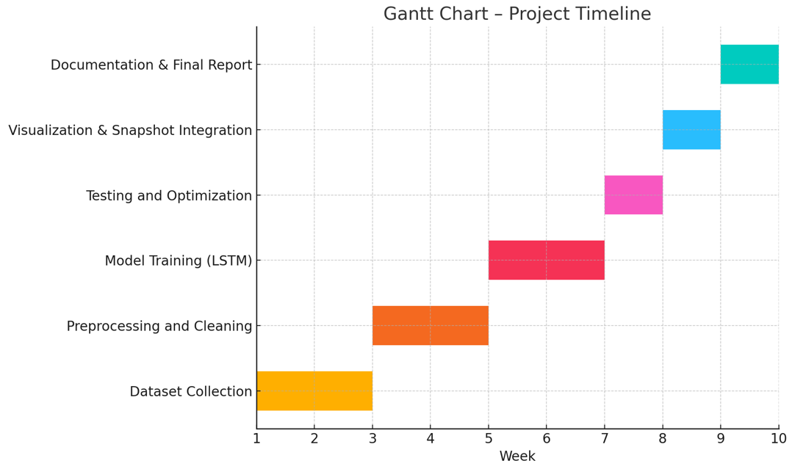
Gantt Chart: Project Timeline

Slide 10
Conclusion
• Developed a predictive system using LSTM for energy usage.
• Achieved high prediction accuracy.
• Model explains correlation with temp and attendance.
• Effective for planning and energy savings.

Slide 11
Limitations and Future Scope
Limitations:
• Static data – no real-time updates
• Limited external features like sunlight intensity
Future Scope:
• IoT integration for live predictions
• API-driven weather data inclusion
• Deploy as full web dashboard

Slide 12
References (IEEE Format)
[1] Y. Zhang et al., 'LSTM-based load forecasting,' IEEE Trans., 2021.
[2] A. Gupta, 'Solar prediction using ML,' Springer, 2022.
[3] M. Liu et al., 'Temperature-aware prediction model,' Elsevier, 2021.
[4] P. Roy, 'Smart grid load modeling,' IEEE Conf., 2020.
[5] S. Alam et al., 'Preprocessing in energy forecasting,' ACM DL, 2022.

Slide 13
Thank You!

